Slide 1
Disordered systems and spin glass

Slide 2
What are we talking about
Disorder and Spin glass
Examples of Spin glass
Example of the use of spin glass theory in other fields
Surprise

Slide 3
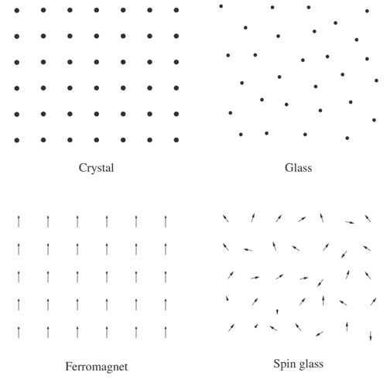
Disorder:
Quenched (time-independent) Disorder.

Slide 4
What is a Spin Glass?
Definition:
Spin glass is a magnetic state characterized by randomness.

Slide 5
Disorder:
$\overset{⃑}{m}=0$

Slide 6

The Hamiltonian:
The Edward Anderson Ising Model (1975):
$$𝓗=−\sum_{\left\langle i,j\right\rangle }{J_{i,j}σ_{i}σ_{j}−H\sum_{i}{σ_{i}}}$$
Where $σ_{i}=±1$ are the Ising Spins.
H is the external magnetic field.
$J_{i,j}$ are the interaction between spins.

Slide 7
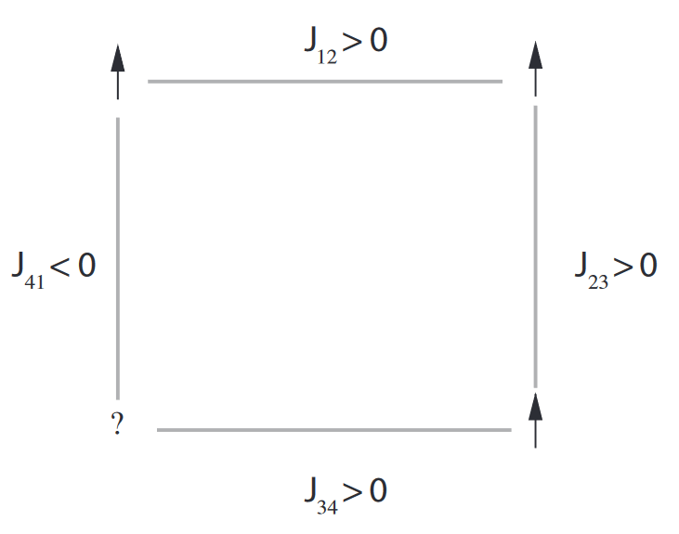
Magnetic Frustration
$\left|J_{i,j}\right|=Const$
$$\prod_{C}{J_{xy}J_{yz}...J_{zx}}<0→frustration$$

Slide 8
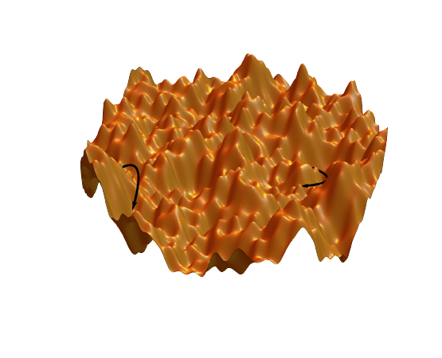
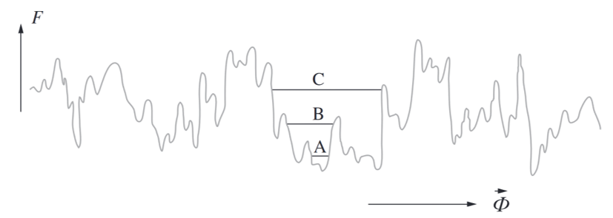
Free-Energy Landscape
A simplified visualization of how the energy varies in the very
high-dimensional space where the coordinate axes represent the
orientation of each individual spin.

Slide 9
Example of a Spin Glass:
The most known Spin Glass system are dilluted metal alloys.
In these metals most of the matter has no magnetic properties and a small portion of it has magnetic properties

Slide 10
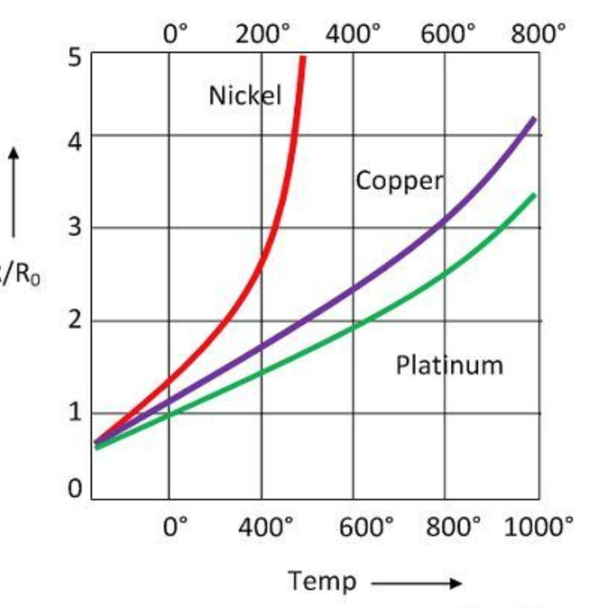
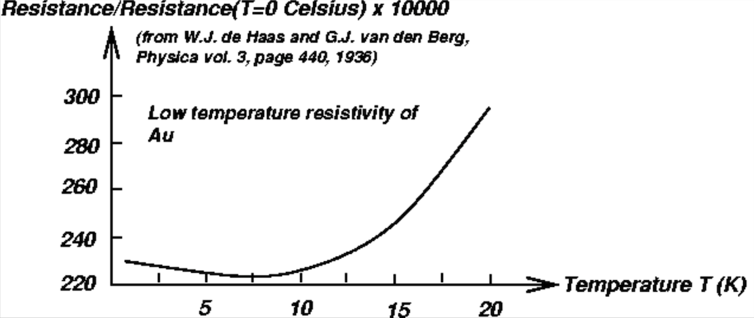
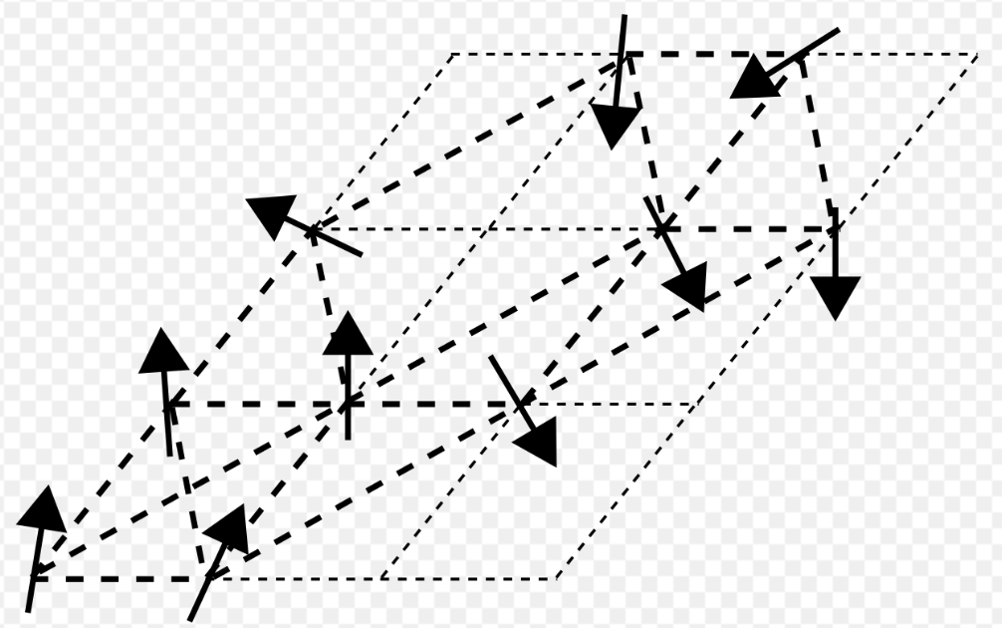
Surprising effects
Kondo effect:
Freezing of the spins at the Freezing temperature:

Slide 11
Why are Spin glass interesting?
They represent a gap in our understanding of the solid state.
Spin Glass research provides mathematical and physical tools to analyse some interesting and hard problems from other fields of interest.

Slide 12
What does Neural Networks have to do with disordered systems and spin-glass?

Slide 13
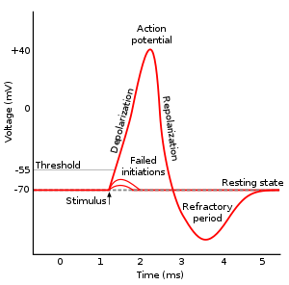
What is a Neuron
Neuron is a biological cell with electrical properties
The cell’s membrane act as a capacitor
Voltage may vary due to Ions movement in and out of the cell
If threshold met the neuron creates an ‘Action potential’

Slide 14
Neural network
A neuron is connected on average to 5,000 other Neurons, which creates a Neural Network
Neurons are connected through synapses
All inputs are summed to reach the threshold

Slide 15
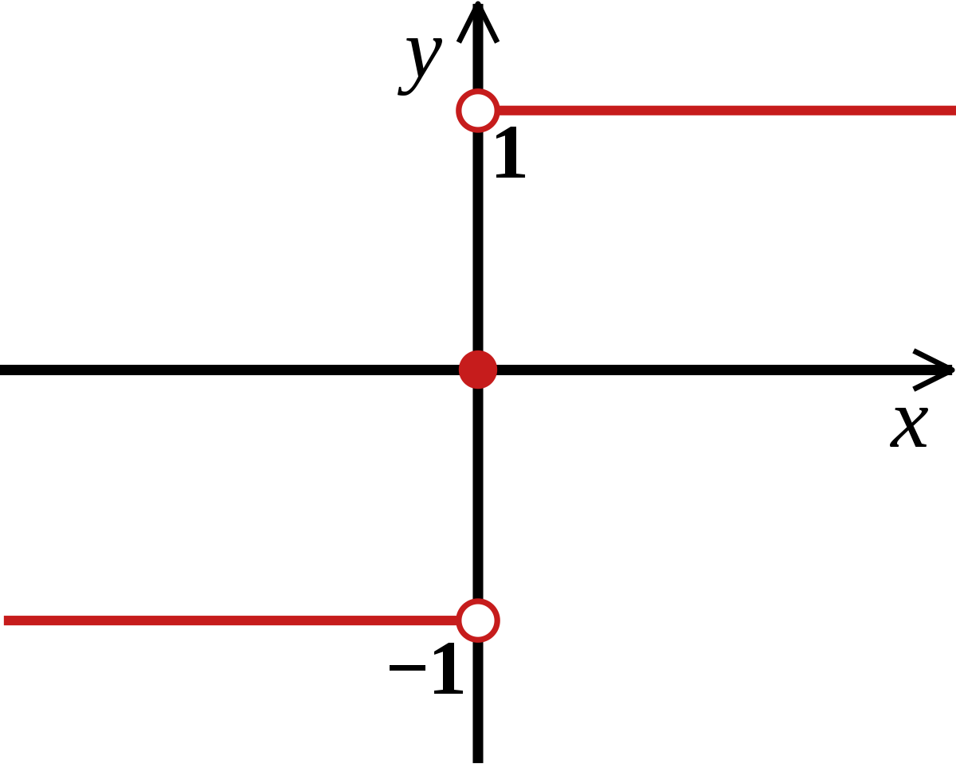
Simplified model of a Neuron
A neuron is modeled by two-state element with multiple inputs and one output :
Activated : 1
Not activated : -1
Analogical to spin states

Slide 16

Hopfield Model
Associative memory
Artificial neural network and a type of spin glass system popularized by John Hopfield

Slide 17
Hopfield Model
Similarity of the systems – neurons are spins and synapses and the bonds
The memories are stored as the minimum energy states in the free-energy landscape

Slide 18

Hopfield Model (energy)
The Hamiltonian of the described system is as of the spin glass model :
$H=−\frac{1}{2}\sum{J_{i,j}σ_{i}σ_{j}}$

Slide 19


Hopfield Model (storing memories)
Assume we want to store $P$ memories - ${\vec{ξ}}^{α}$ $1≤α≤P$
We define the bonds $J_{ij}$as :
$$J_{ij} =\frac{1}{N}\sum_{α=1}^{p}{ξ_{i}^{α}⋅ξ_{j}^{α}}$$

Slide 20

Hopfield Model (dynamics)
This system must include dynamics
The Monte-Carlo spin flip works as follows:
Choose one neuron randomly $σ_{i}$
Calculate the networks input to it at time $t$: $∑J_{ij}σ_{j}(t)$
If the threshold is reached then the neuron is activated:
$σ_{i}\left(t+δt\right)=sign(∑J_{ij}σ_{j}(t)$)

Slide 21

Hopfield Model (dynamics)
We can show that by defining $J_{ij}$as we did, the states ${\vec{ξ}}_{}^{α}$ are stable under the dynamics e.g.local minima of the energy:
${\vec{ξ}}_{i}^{α}\left(t+δt\right)=sign\left(\sum_{j=1}^{N}{J_{ij}{\vec{ξ}}_{j}^{α}}\right)=sign\left(\frac{1}{N}\sum_{j=1}^{N}{{\vec{ξ}}_{i}^{α}⋅{\vec{ξ}}_{j}^{α}⋅{\vec{ξ}}_{j}^{α}}\right)= sign\left(\frac{1}{N}\sum_{j=1}^{N}{{\vec{ξ}}_{i}^{α}⋅{\vec{ξ}}_{j}^{α}}\right)=sign(\frac{1}{N}\sum_{j=1}^{N}{{\vec{ξ}}_{i}^{α})=sign({\vec{ξ}}_{i}^{α})}={{\vec{ξ}}_{i}^{α}(t)}_{}$

Slide 22
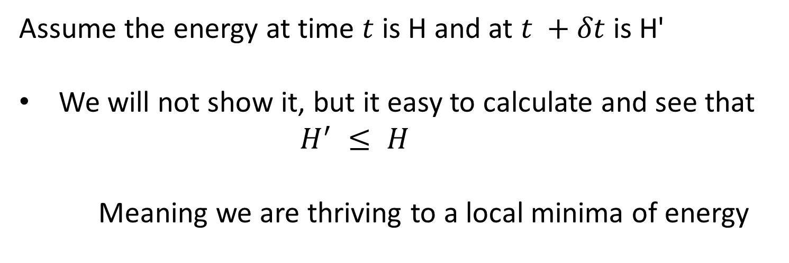
Hopfield Model (dynamics)
Assume the energy at time $t$ is H and at $t +δt$is H'
We will not show it, but it easy to calculate and see that
$$H^{′} ≤ H$$
Meaning we are thriving to a local minima of energy

Slide 23
Implementation

Slide 24
Storing the memories in the neuron network
Adding “noise” to one of the memories
Cleaning out the noise and converging to a memory

Slide 25
First example

Slide 26
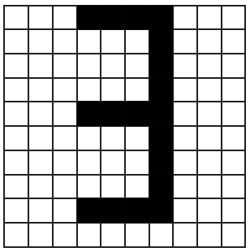
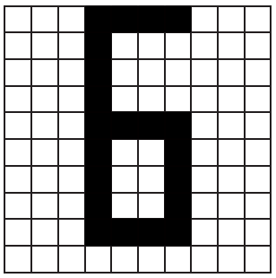
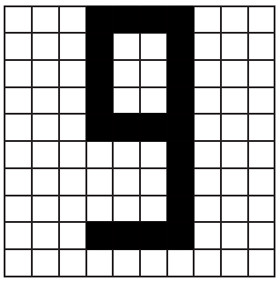




The memories
$${\vec{ξ}}^{3}=\left(\begin{matrix}−1 \\ −1 \\ \begin{matrix}1 \\ ⋮ \\ −1\end{matrix}\end{matrix}\right)$$
$${\vec{ξ}}^{2}=\left(\begin{matrix}1 \\ 1 \\ \begin{matrix}−1 \\ ⋮ \\ 1\end{matrix}\end{matrix}\right)$$
$${\vec{ξ}}^{1}=\left(\begin{matrix}1 \\ −1 \\ \begin{matrix}1 \\ ⋮ \\ −1\end{matrix}\end{matrix}\right)$$
$$J_{ij} =\frac{1}{N}\sum_{α=1}^{p}{ξ_{i}^{α}⋅ξ_{j}^{α}}$$

Slide 27
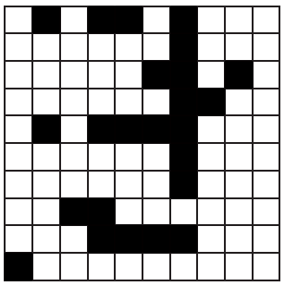
Starting state

Slide 28
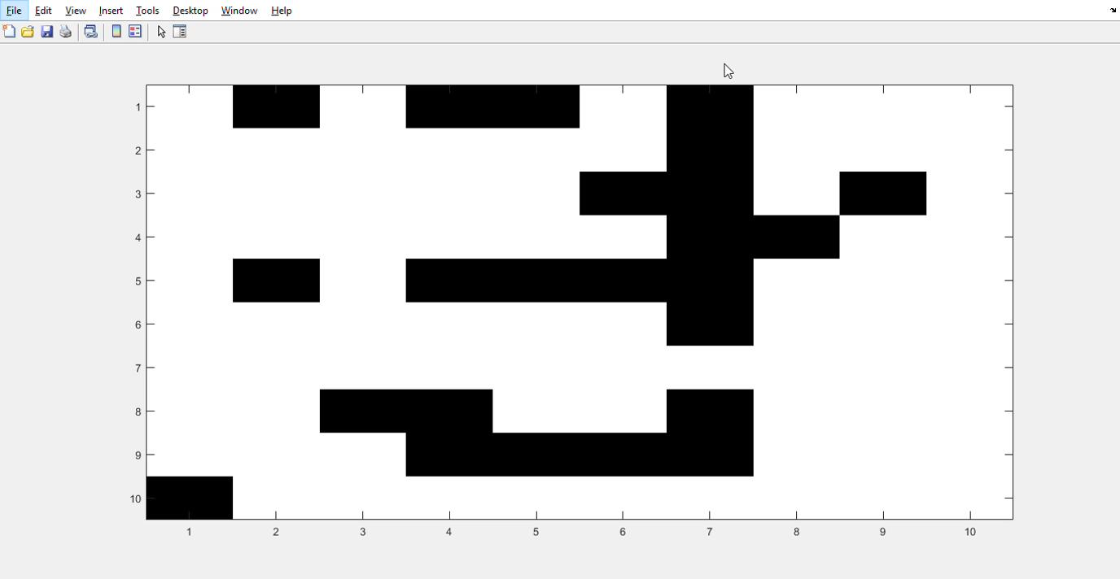

Slide 29
Second example

Slide 30
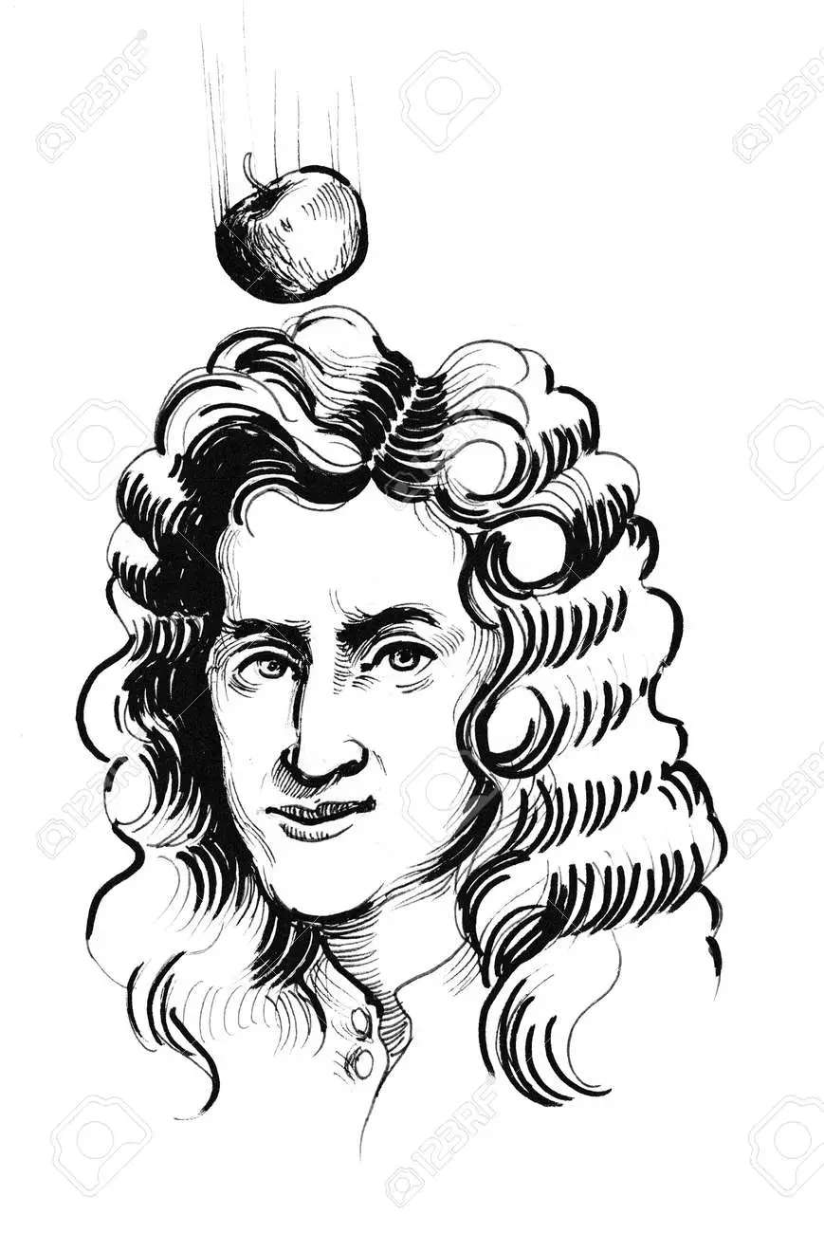

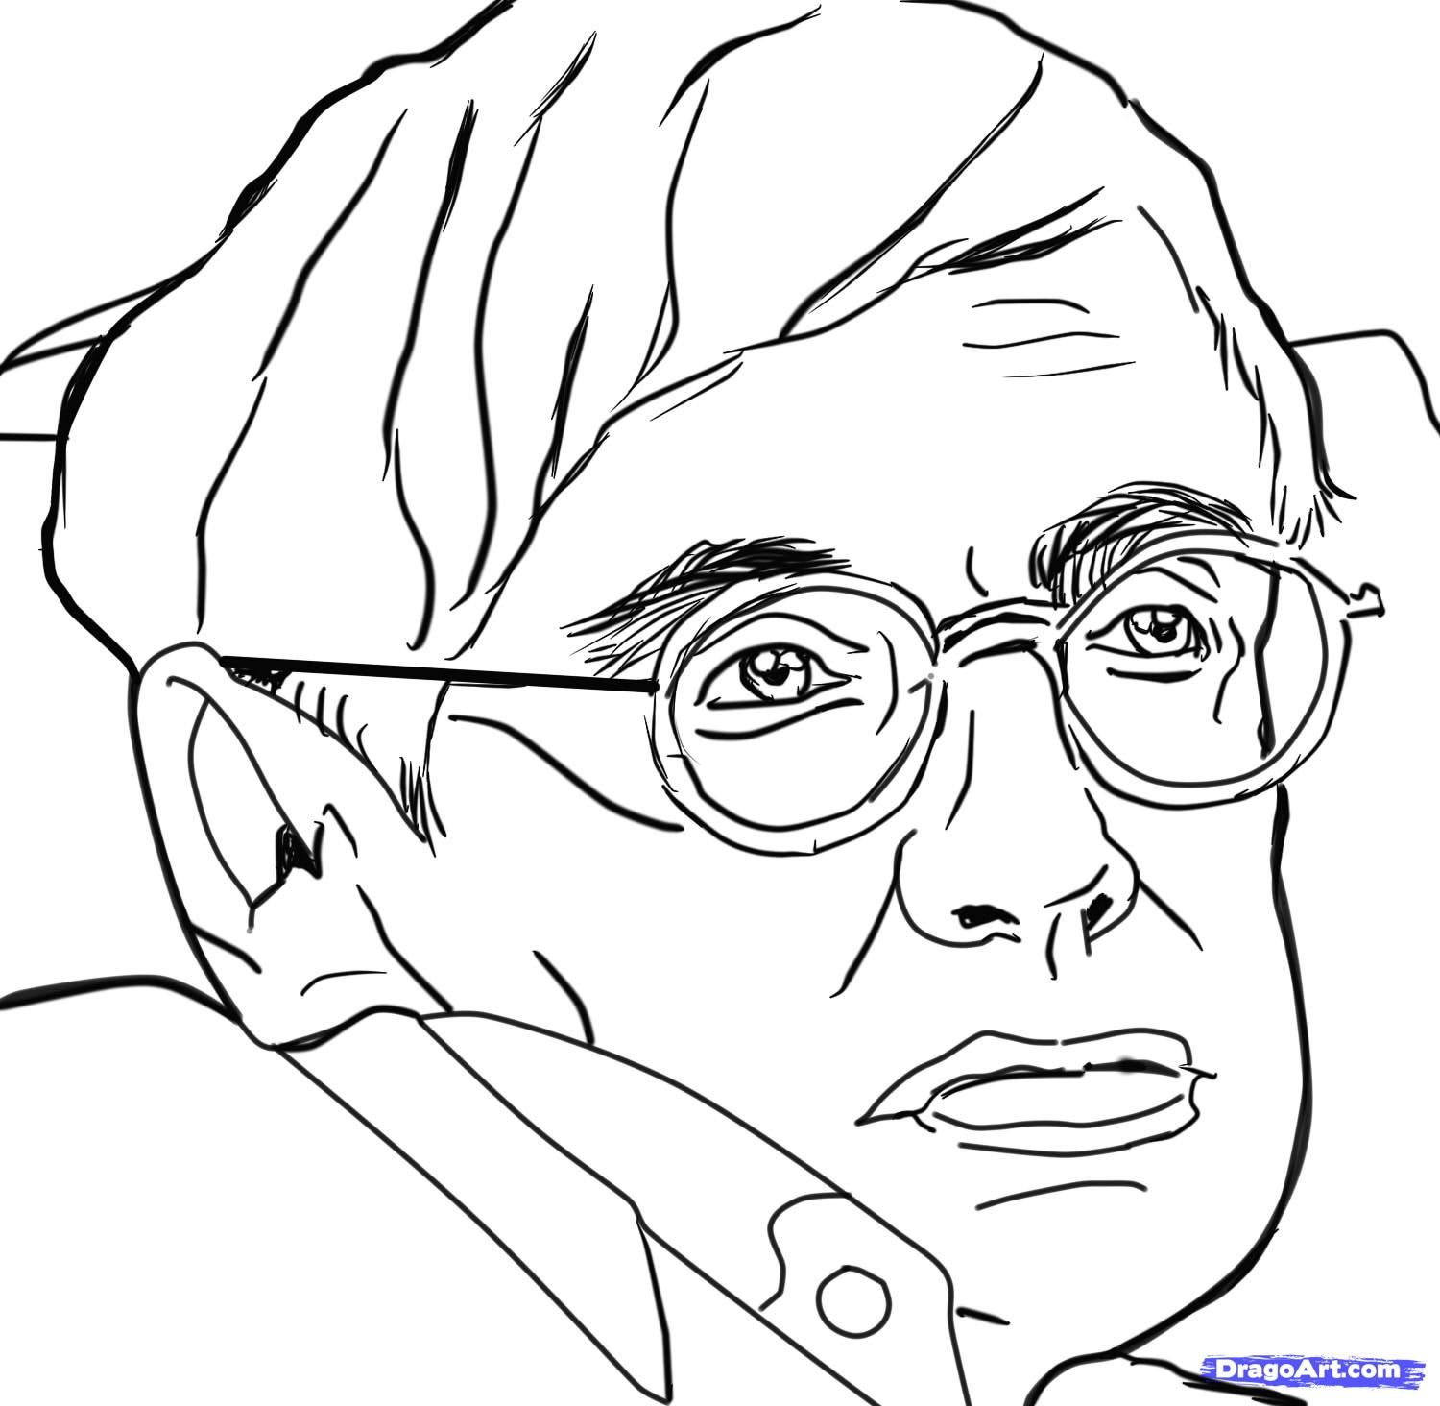

The memories
$${\vec{ξ}}^{3}=\left(\begin{matrix}−1 \\ −1 \\ \begin{matrix}1 \\ ⋮ \\ −1\end{matrix}\end{matrix}\right)$$
$${\vec{ξ}}^{2}=\left(\begin{matrix}1 \\ 1 \\ \begin{matrix}−1 \\ ⋮ \\ 1\end{matrix}\end{matrix}\right)$$
$${\vec{ξ}}^{1}=\left(\begin{matrix}1 \\ −1 \\ \begin{matrix}1 \\ ⋮ \\ −1\end{matrix}\end{matrix}\right)$$
$$J_{ij} =\frac{1}{N}\sum_{α=1}^{p}{ξ_{i}^{α}⋅ξ_{j}^{α}}$$

Slide 31

Starting state

Slide 32
